Slide 1


Lyme Disease: Case Trends, Climate, and Risk Across the U.S.
Daniel zapata
Nashville software school

Slide 2
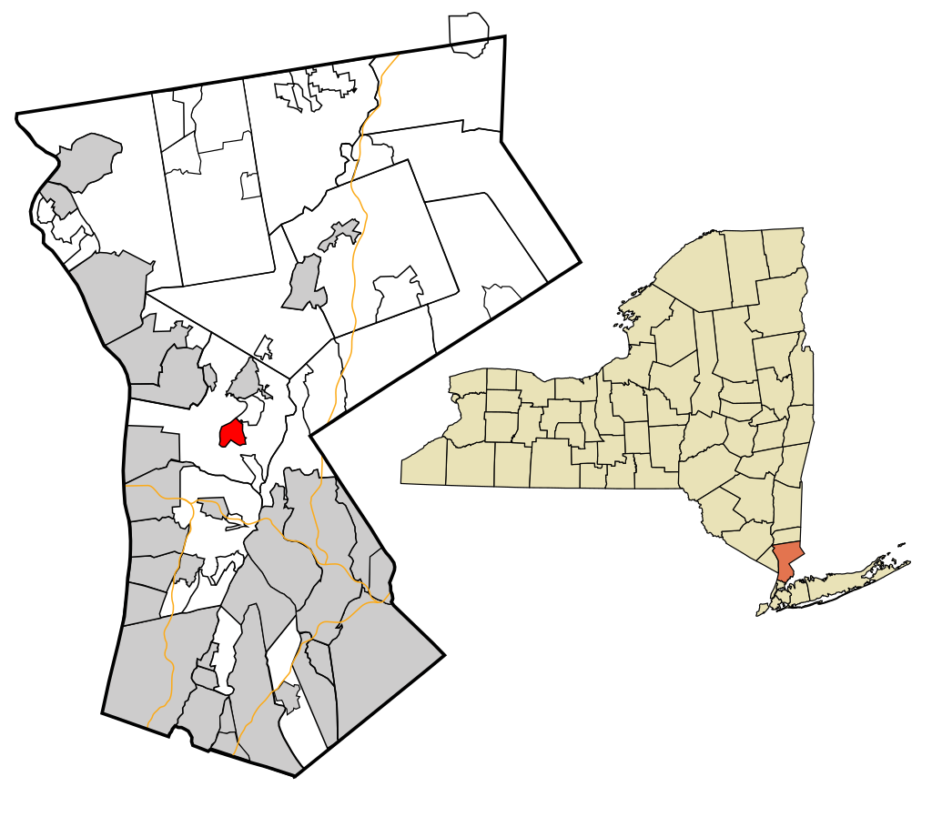
Motivation
01. Grew up in New York
02. Spent time outdoors
03. Road trips
04. Contracted Lyme disease twice
05. Explore risk in Nashville, TN
Notes:
I grew up in NY about 30 miles north of New York City.
I spent a decent amount of time outdoors, but not in the woods. Outside in the yard, local parks, etc. We were not a camping family
Did a lot of road trips as a family throughout the NE- especially PA, Conn, Massachusetts. Visit amusement parks, college visits for my older siblings
I contracted Lyme disease twice as a kid. Once when I was around 10 and then another time around 13 or so. I had the typical symptoms with recognizable rash, so my mom brought me to the doctor and I was able to get treated early and was completely fine.
Then I moved down to Nashville in 2012 and remember being told by my now mother-in-law that there really wasn’t any Lyme down here, which I easily accepted, but never really looked into. This capstone project allowed me to actually dig into the data and see if that claim was true or not, which is my overall motivation for exploring this data.

Slide 3




Questions to Explore
How has Lyme disease changed over the past several decades in the United States?
Which states are most affected by Lyme disease and has that changed over time?
Which states have experienced the most significant increase in cases?
Is there a relationship between winter temperatures and case counts?
Does adjusting for population change which states are considered most at risk?
What is the risk of Lyme disease in Tennessee and specifically, Davidson County?
Notes:
How has Lyme disease changed over the past several decades in the United States?
Which states are most affected by Lyme disease and has that changed over time?
Which states have experienced the most significant increase in cases?
Is there a relationship between winter temperatures and case counts?
Does adjusting for population change which states are considered most at risk?
What is the risk of Lyme disease in Tennessee and specifically, Davidson County?

Slide 4
Data Sources
Centers for Disease Control and Prevention (CDC)
National Centers for Environmental Information
United States Census Bureau
Case counts by month and year
Case counts by state
Case counts by county
US average monthly temperatures
Regional average temperatures
State average temperatures
US population by year
State populations by year
Tennessee County populations by year
Notes:
I used three main data sources:
The CDC for datasets with case counts by month and year as well as by county and state.
The National Centers for Environmental Information for data on average temperatures on a national, regional, and state level. I could filter the data and get an average temperature for specific time frames.
And finally the US Census Bureau to retrieve data on the US population, state populations, and county populations by year.

Slide 5
Goals for Q2
Added priorities
Employee opportunities
Increase customer satisfaction by 2%
Maintain growth
Decrease the number of rotations by at least 2
Ensure the cost of development stays below budget
Interns begin
Indoor rec leagues
Chess tournaments
Big Game watching party
Food drive
Business priorities
Business priorities

Slide 6
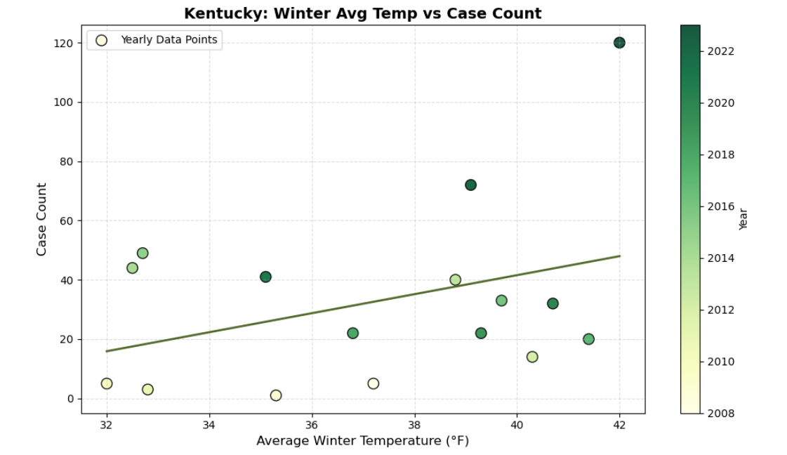
Growth by sector table

Slide 7
Growth by sector chart

Slide 8
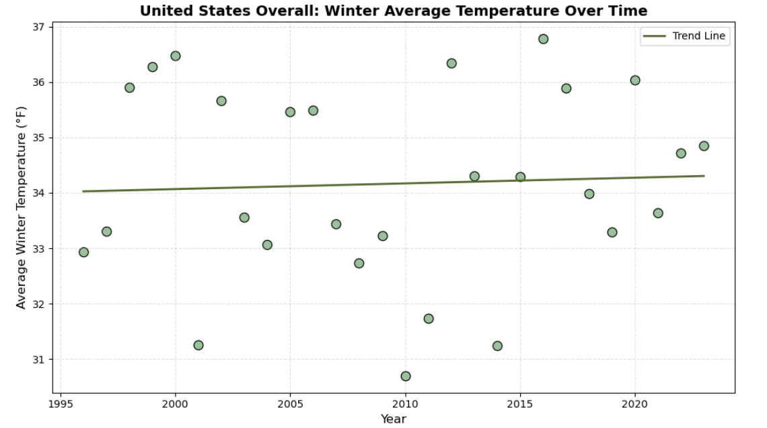

Slide 9
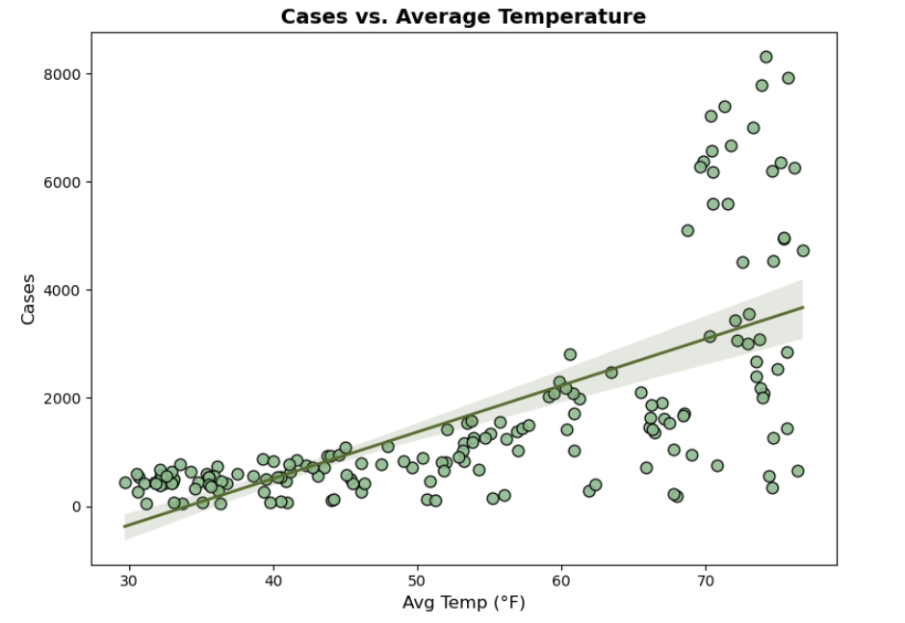
Growth by sector chart

Slide 10




Our team
Portrait of a team member
Ana
Larissa
Roman
Federico
CEO
CFO
CTO
COO

Slide 11
Goals for Q1
Business priorities
Employee opportunities
Increase customer satisfaction by 2%
Maintain growth
Diversify investment in sector 2
Initiative partnership with 3rd party organizations
End of fiscal celebration on July 15th
Employee day of learning on August 14th
Employee Yoga on September 3rd
Seminar series begins September 10th

Slide 12
Goals for Q1

Slide 13
Goals for Q2
Business priorities
Added priorities
Employee opportunities
Increase customer satisfaction by 2%
Maintain growth
Decrease the number of rotations by at least 2
Ensure the cost of development stays below budget
Interns begin
Indoor rec leagues
Chess tournaments
Big Game watching party
Food drive

Slide 14

Thank you
Thanks to your commitment and strong work ethic, we know next year will be even better than the last.
We look forward to working together.
Contoso
sales@contoso.com

